Slide 1


Slide 2
Objectives
At the end of this module, you will be able to understand:
Android Developer Work-Flow
Android Studio & Genymotion
Designing and Developing in Android
Testing your App using Mockito & Robolectric

Slide 3
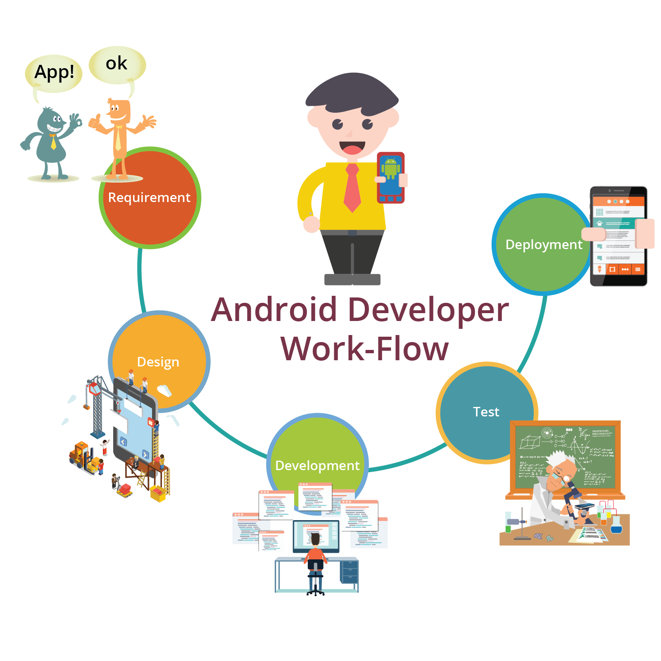
Android Developer Work-Flow

Slide 4

Android Studio
Android Studio is the official IDE for Android application development, based on IntelliJ IDEA
Tool used by every Android Developer

Slide 5
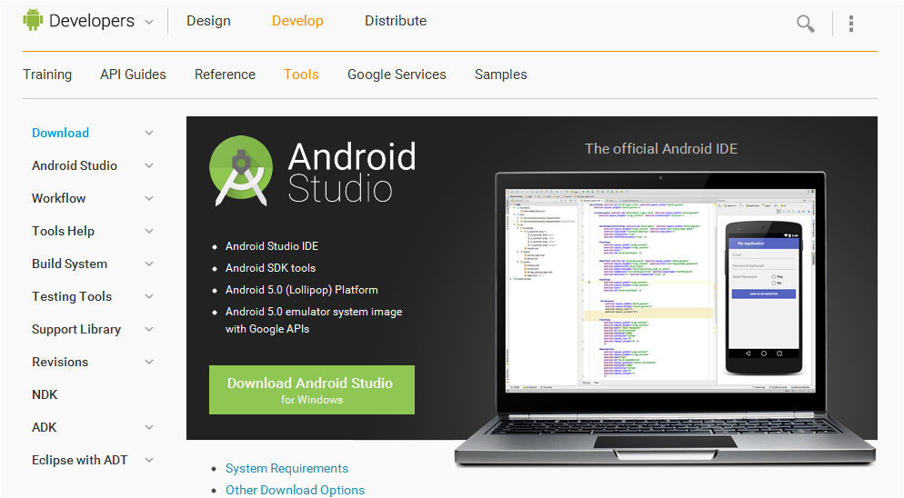
Android Studio Setup (Contd.)
Download Android Studio : http://developer.android.com/sdk/index.html
Click on Download Android Studio Windows

Slide 6
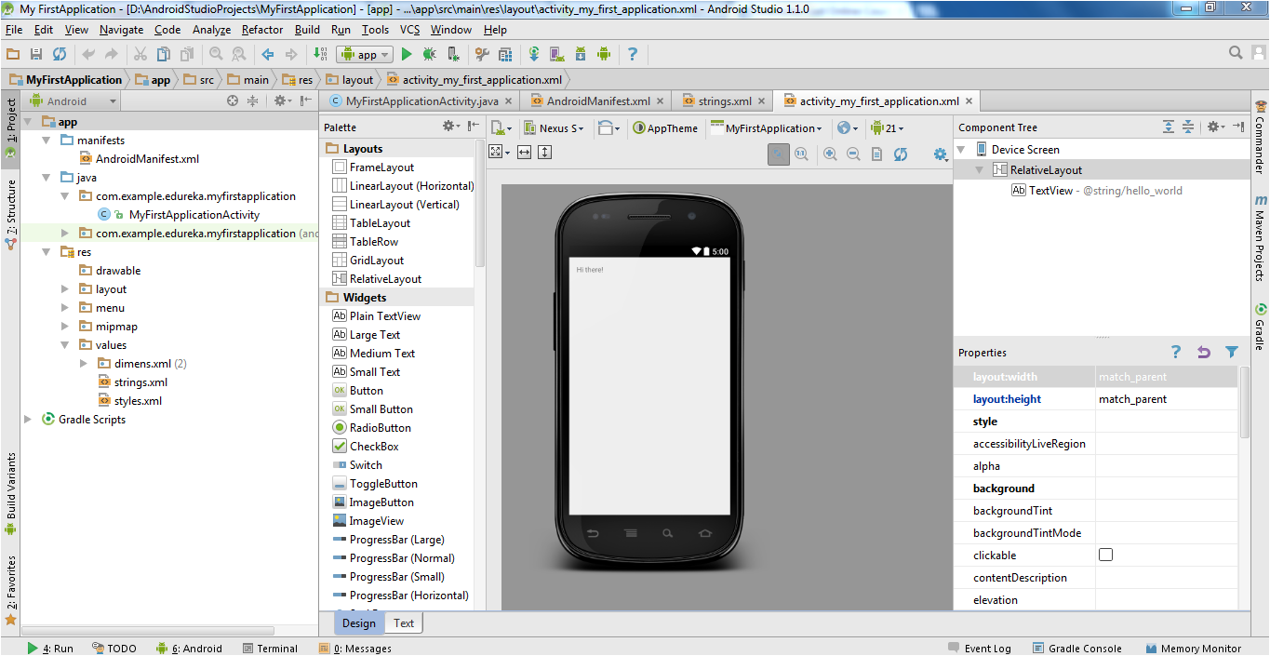
Android Studio Welcome Page

Slide 7
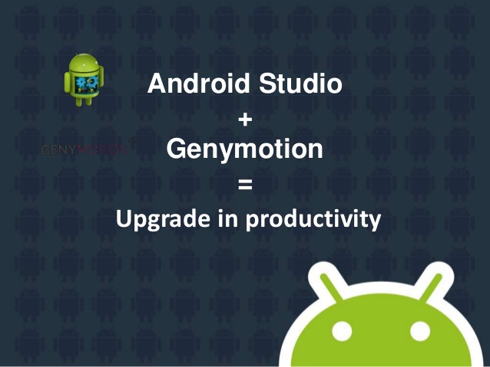
Android Studio + Genymotion

Slide 8

Requirement
Defining scope of the project
Analyzing each requirement carefully

Slide 9

Design
Building the User Interface
Look and Feel of an App

Slide 10

Development
This is the phase where programming skills are shown
Coding is done to give life to your application and making the functionalities work as they are suppose to

Slide 11
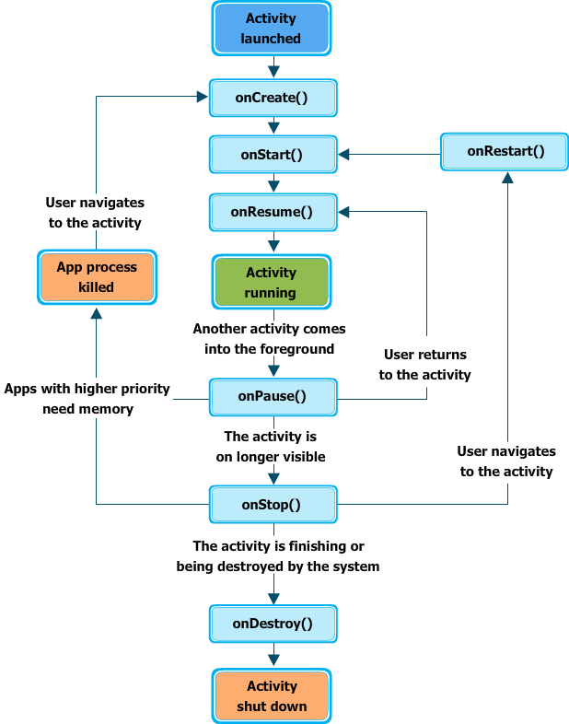
Activity Lifecycle

Slide 12
Activity Lifecycle (Contd.)
Create
In this state, the activity is created
Resumed
In this state, the activity is in the foreground and the user can interact with it. (Also sometimes referred to as the "running" state.)
Paused
In this state, the activity is partially obscured by another activity-the other activity that's in the foreground is semi-transparent or doesn't cover the entire screen
The paused activity does not receive user input and cannot execute any code
Stopped
In this state, the activity is completely hidden and not visible to the user. it is considered to be in the background.
While stopped, the activity instance and all its state information such as member variables is retained, but it cannot execute any code
Destroy
In this case the activity is destroyed and removed from the memory

Slide 13
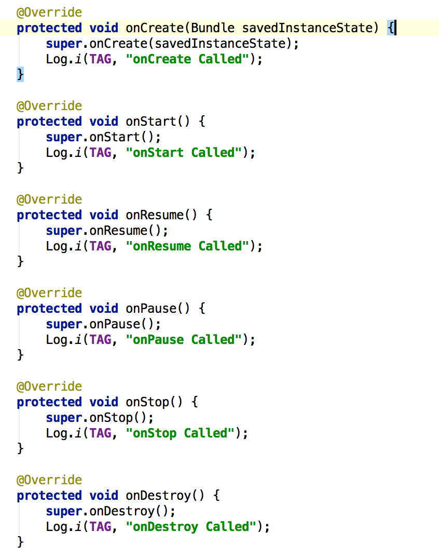
Activity Lifecycle (Contd.)

Slide 14

Testing With Mockito
According to Mockito creators:
Mockito is a mocking framework that tastes really good. It lets you write beautiful tests with clean & simple API. Mockito doesn’t give you a hangover because the tests are very readable and they produce clean verification errors.

Slide 15
Testing With Mockito
Demo

Slide 16


Testing With Robolectric
Wouldn't it be nice to run your Android tests directly from inside your IDE?
Robolectric is a unit test framework that de-fangs the Android SDK jar so you can test-drive the development of your Android app. Tests run inside the JVM on your workstation in seconds.

Slide 17

Deployment
Android application deployment is a process that makes your Android applications available to users.
This is the last phase of the Android application development process.
You can start selling or distributing free using Google Play (A famous Android marketplace)

